Slide 1
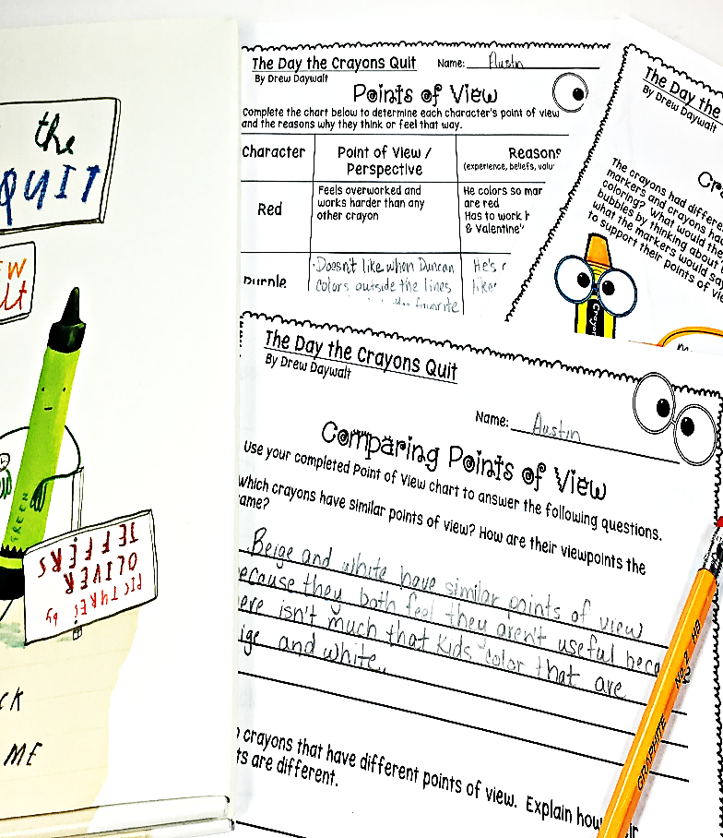
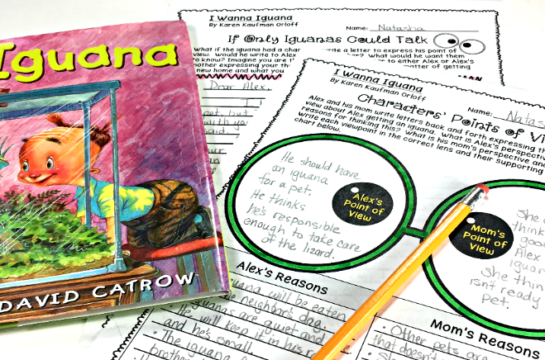
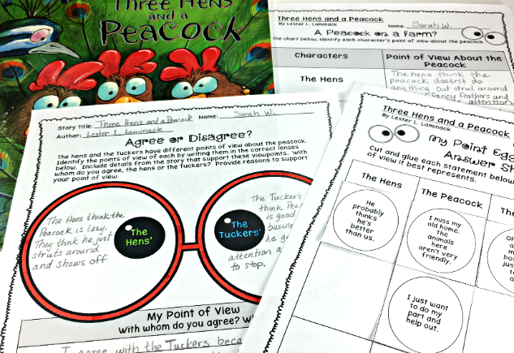
OVER 35 ACTIVITIES
FOR 5 READ ALOUDS
POINT OF VIEW & PERSPECTIVE
Grades
3rd – 5th

Slide 2
This comprehensive bundle is packed with a variety of rigorous activities intentionally designed to teach point of view using five read aloud stories specifically selected to explore these standards:
Through these various activities, students will:
Determine the narrator’s and/or character’s perspective within a story based on their experiences, beliefs, values and/or attitudes
Distinguish between the character’s or narrator’s point of view and that of the reader’s
Evaluate the narrator’s or character’s perspective
Determine the points of view from which stories are narrated
Describe how the narrator’s point of view influences the way a story is told
Compare and contrast the points of view from which different stories are told
Infer and describe how an account of a story would be different if narrated from a different point of view
Describe how a character’s perspective can change within a story
Determine which important details within a story support all of the above
This toolkit also includes other resources that can be used with any story to revisit these standards & skills throughout the year.
CCSS.ELA-LITERACY.RL.3.6 Distinguish their own point of view from that of the narrator or those of the characters.
CCSS.ELA-LITERACY.RL.4.6 Compare and contrast the point of view from which different stories are narrated, including the difference between first- and third-person narrations.

Slide 3
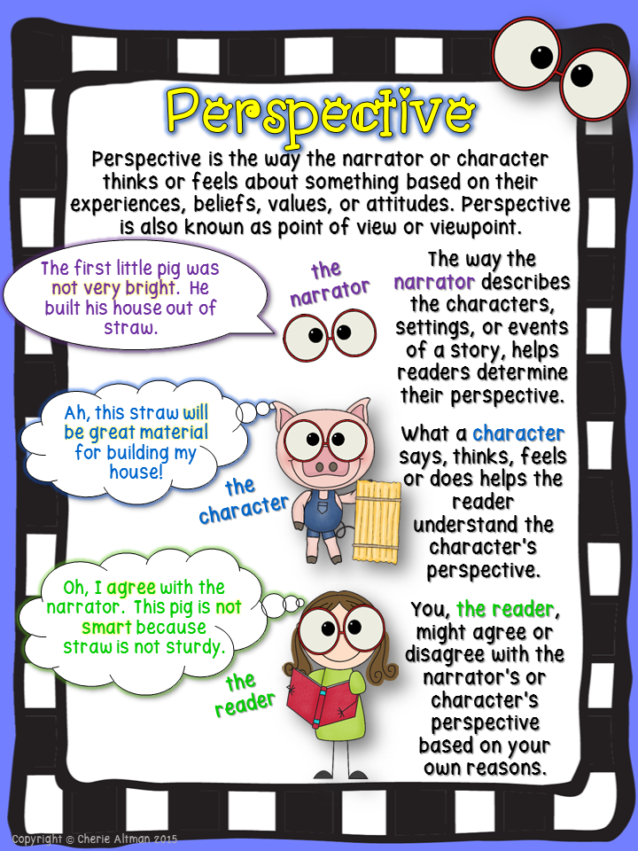
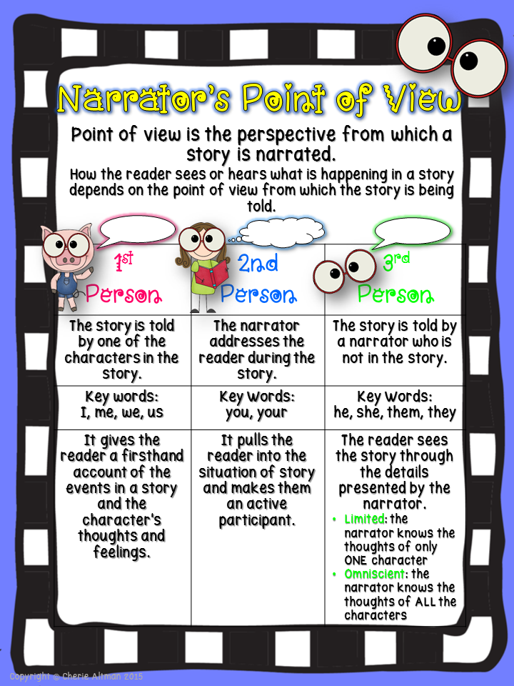
Point of View Standards-Based
Anchor Charts

Slide 4
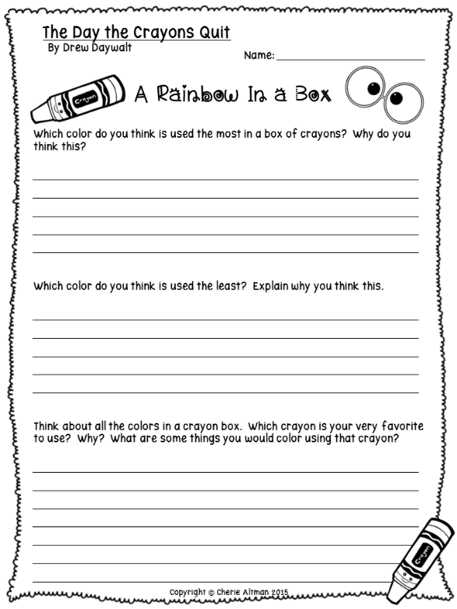
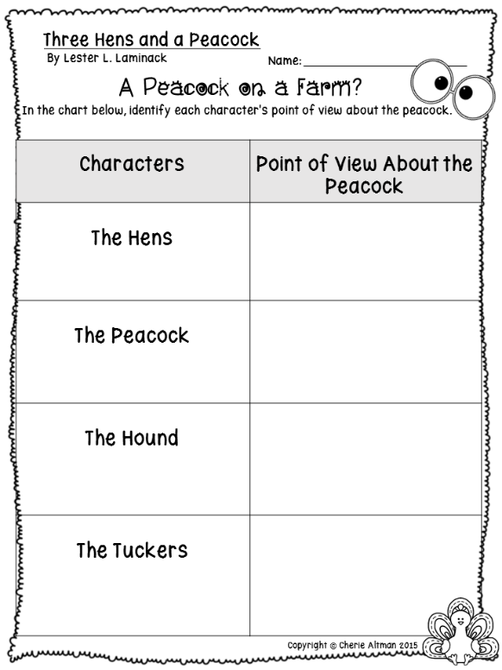
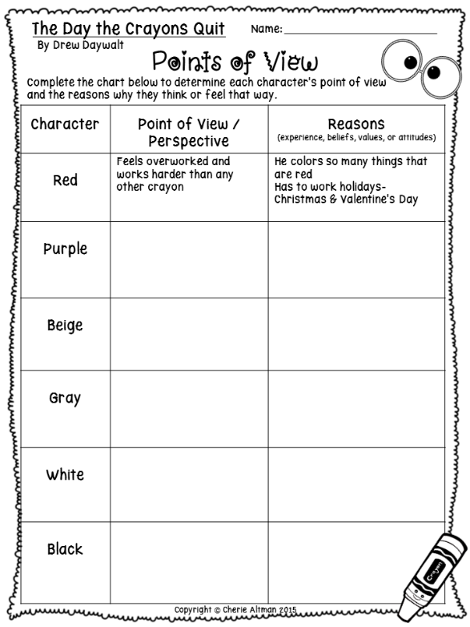
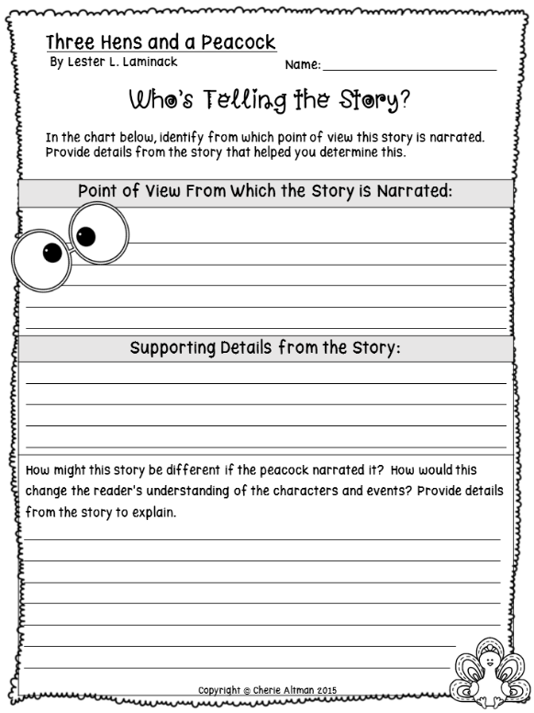
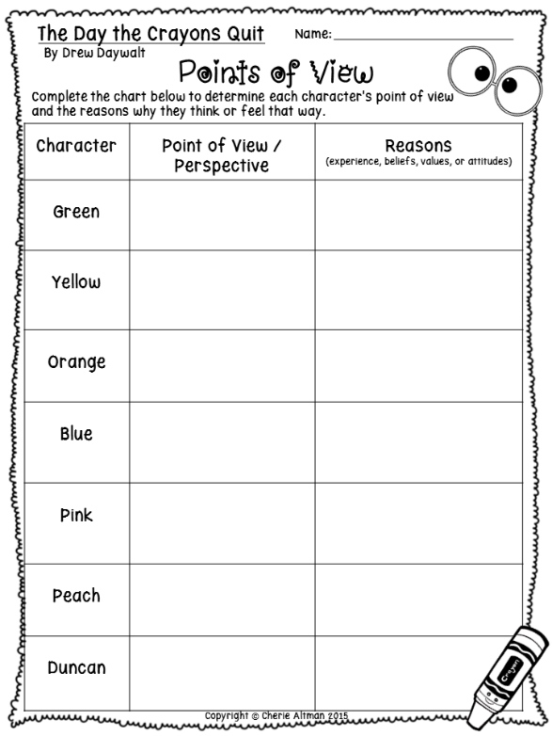
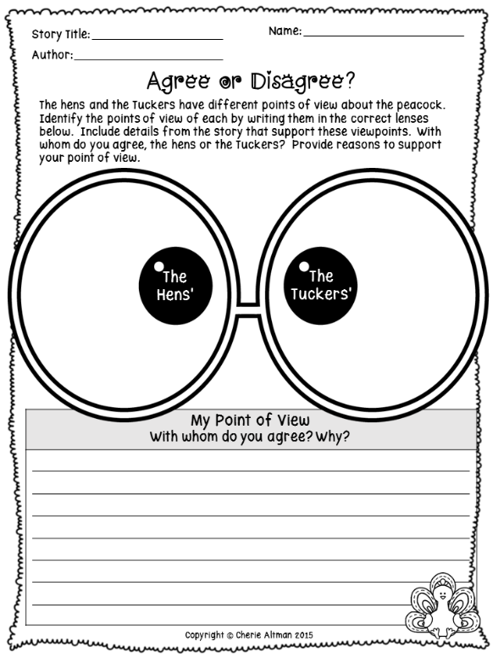
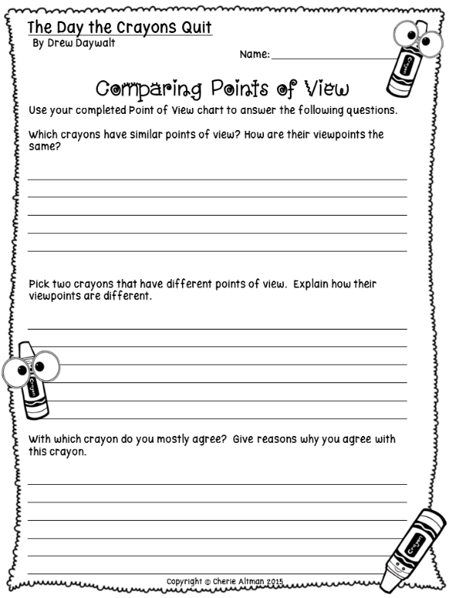
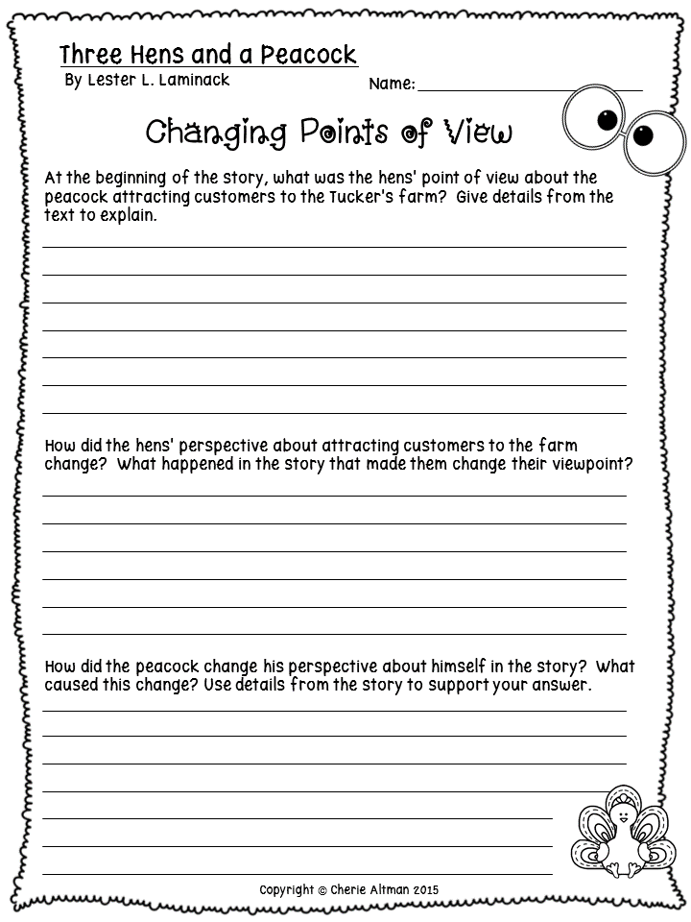
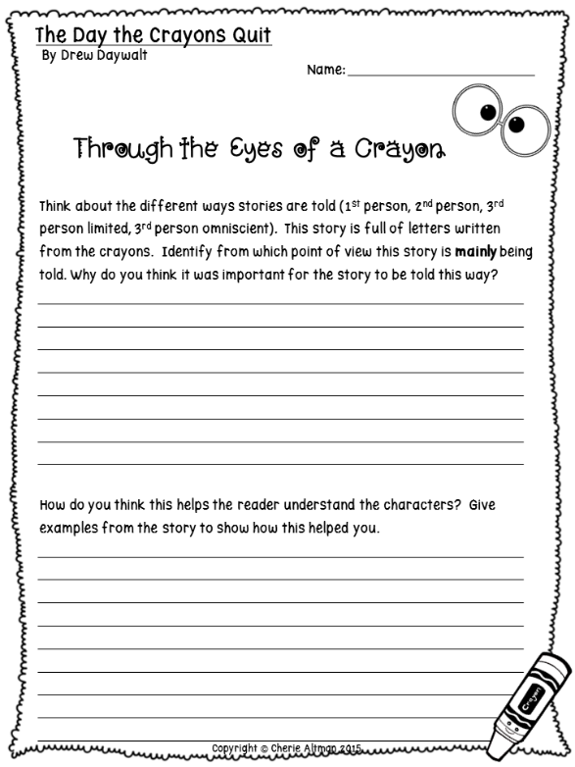
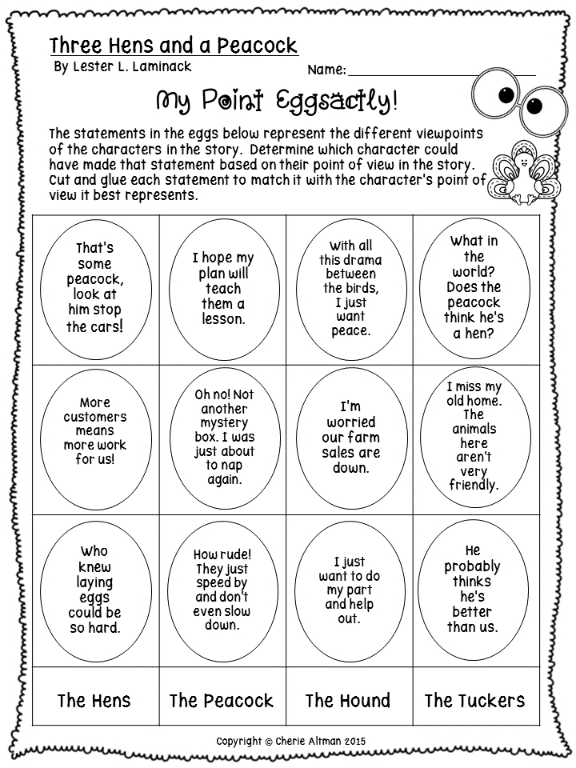
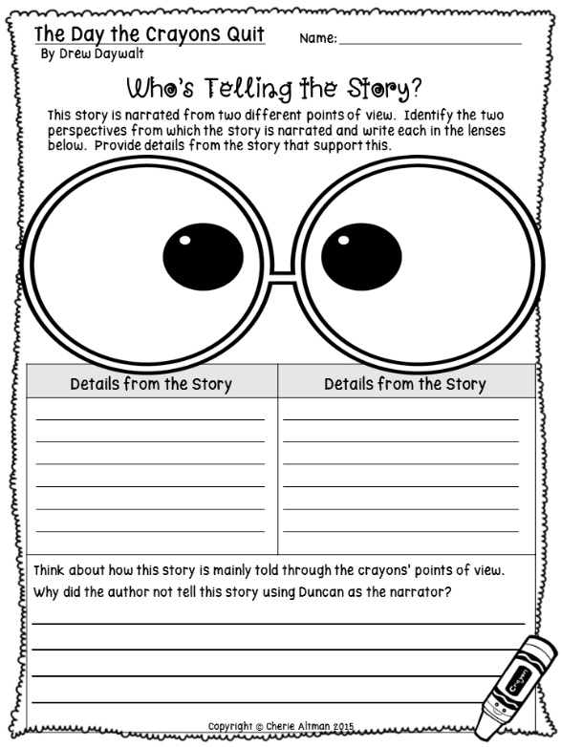
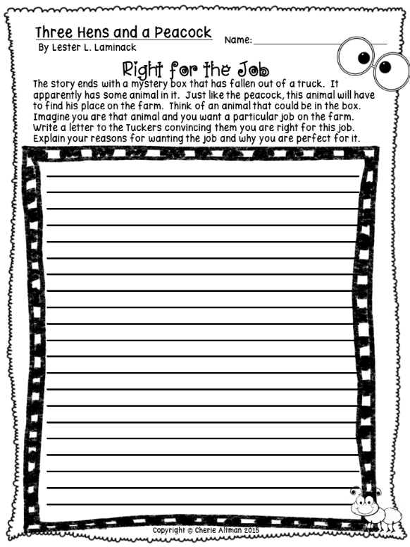
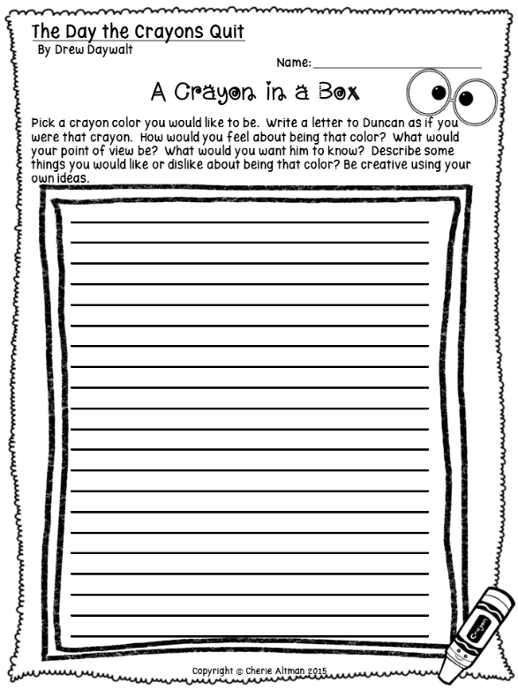
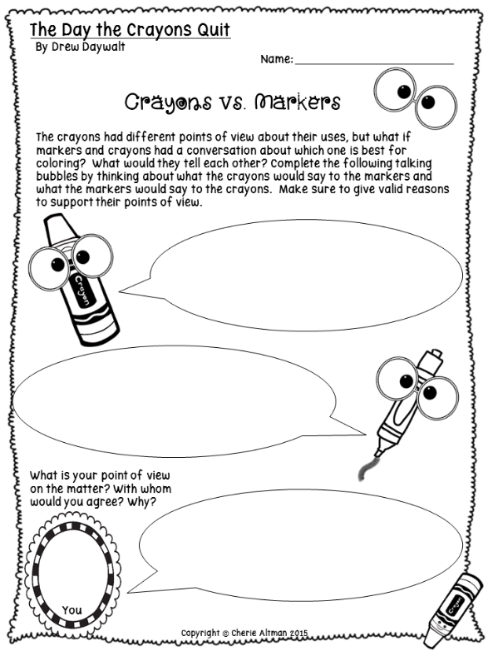
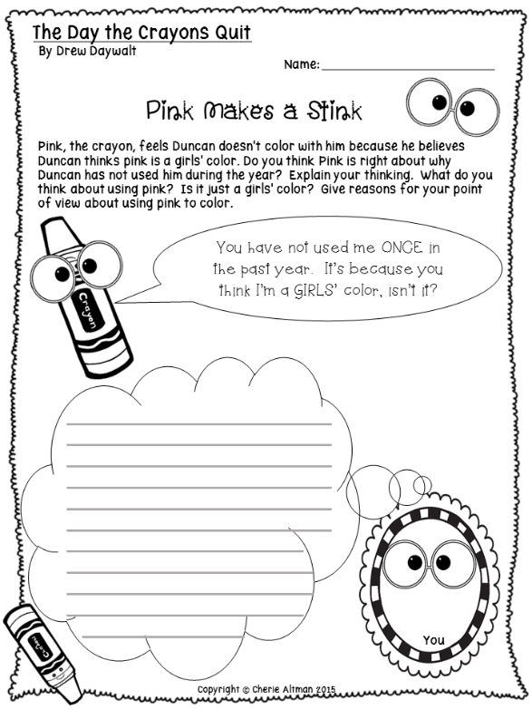
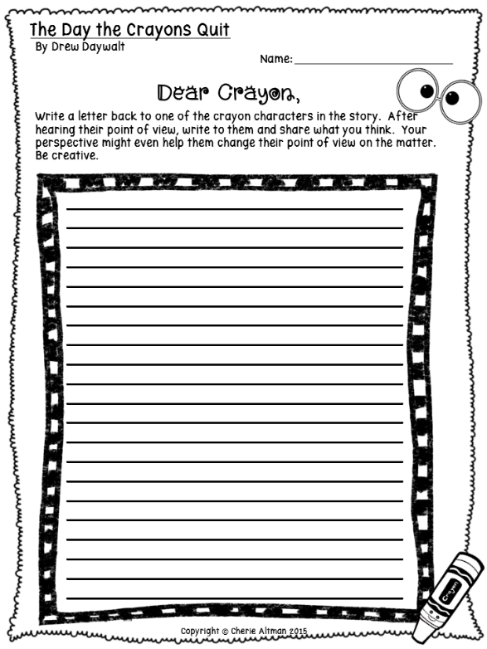
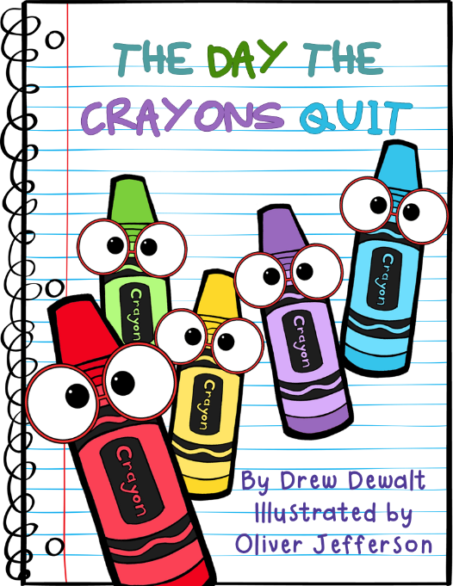
Over 35 POV Activities Specific to These 5 Fun Read Alouds!

Slide 5
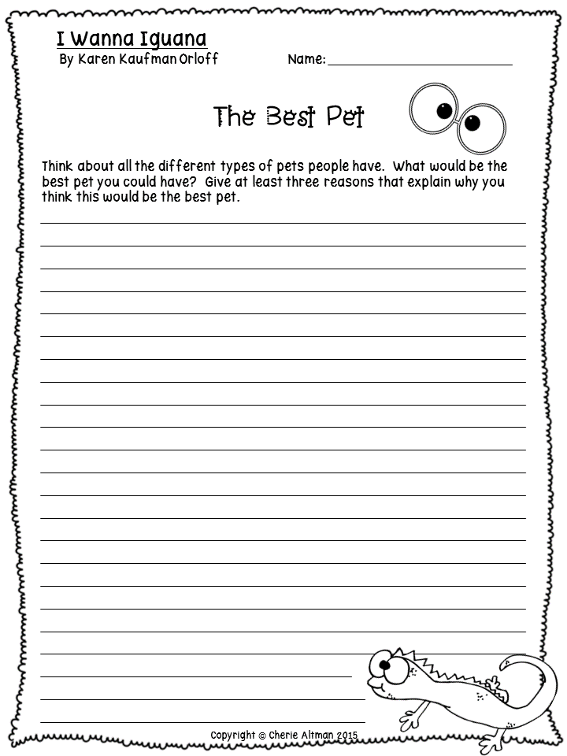
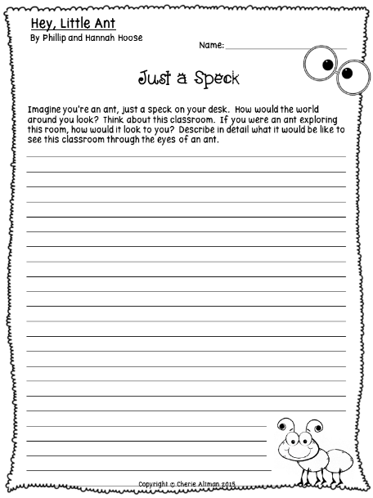
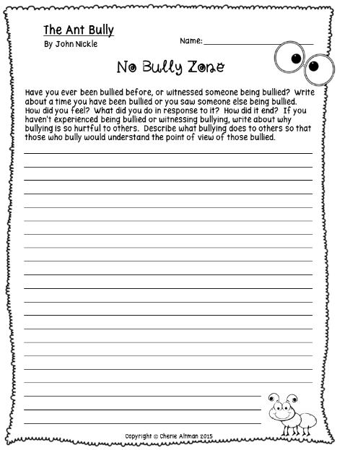
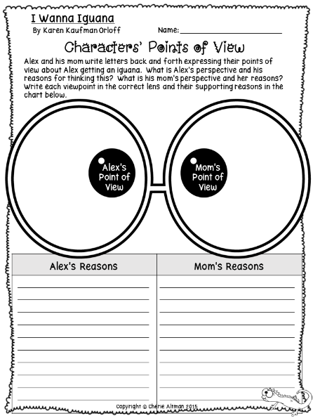
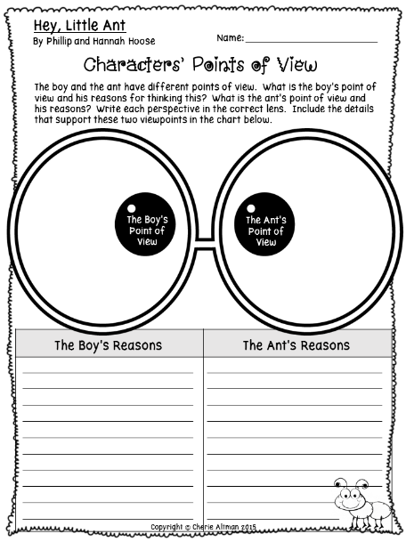
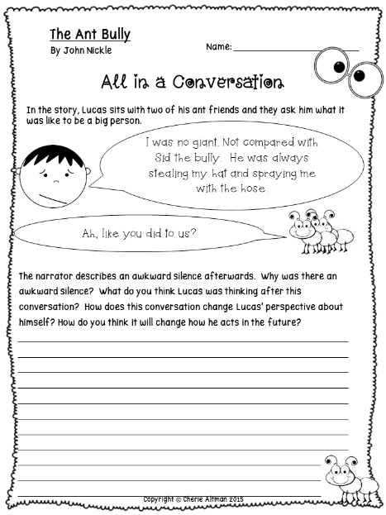
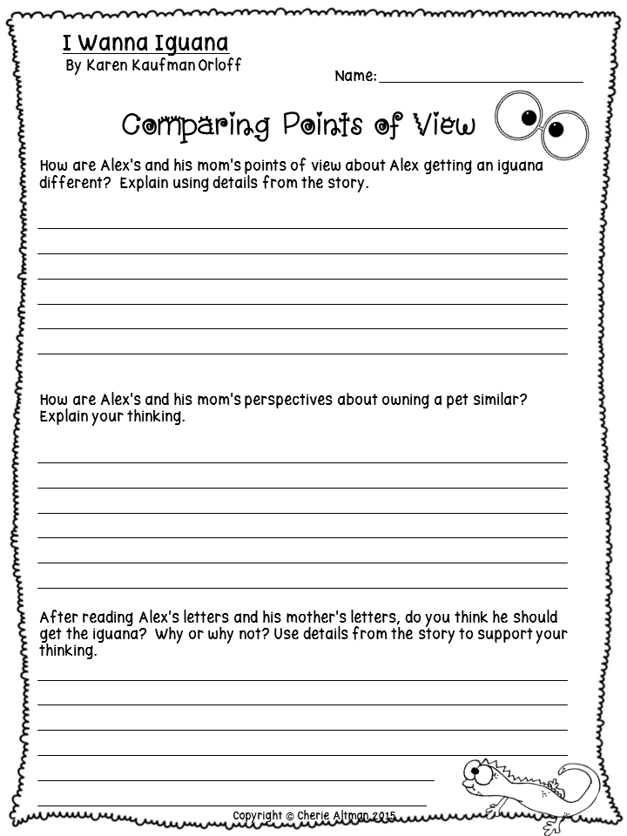
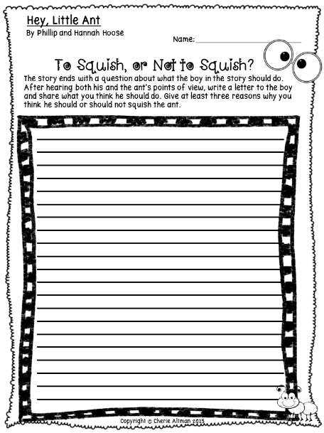
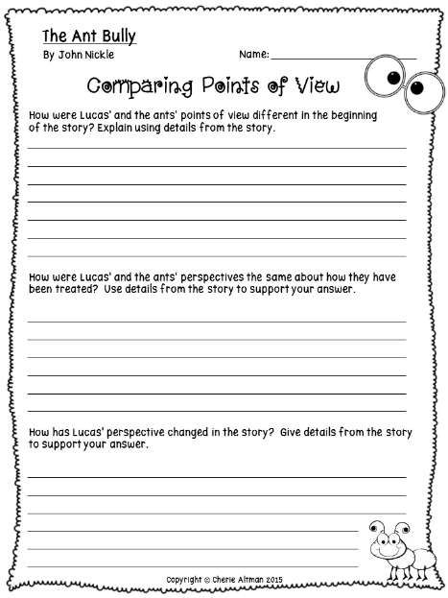
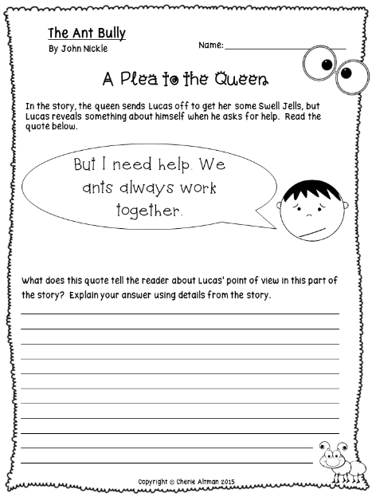
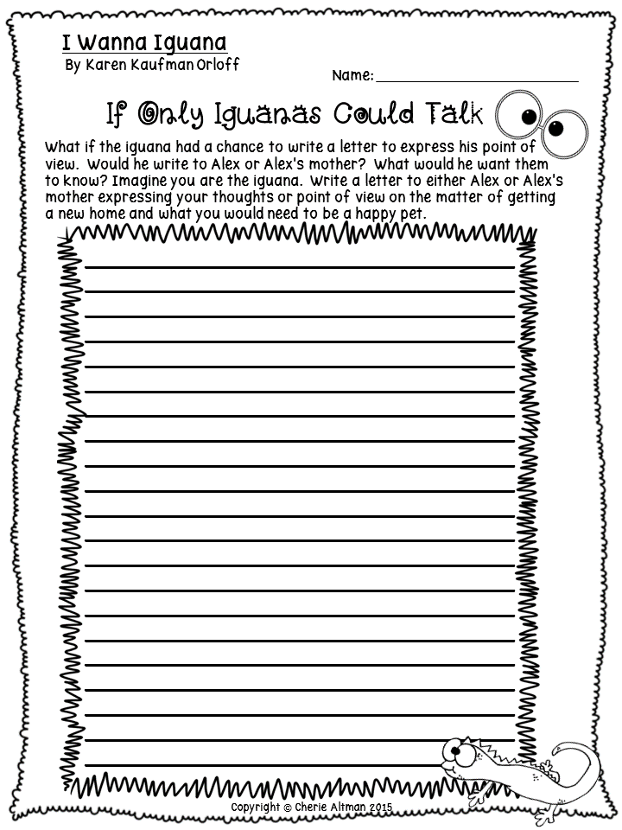
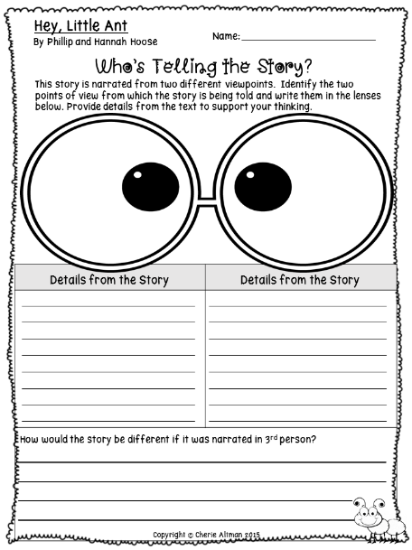
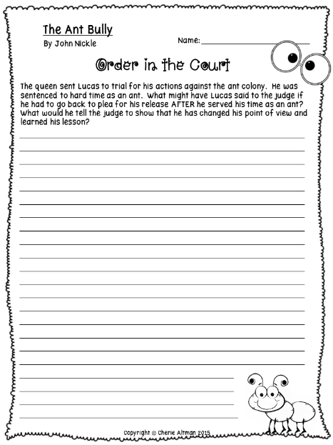
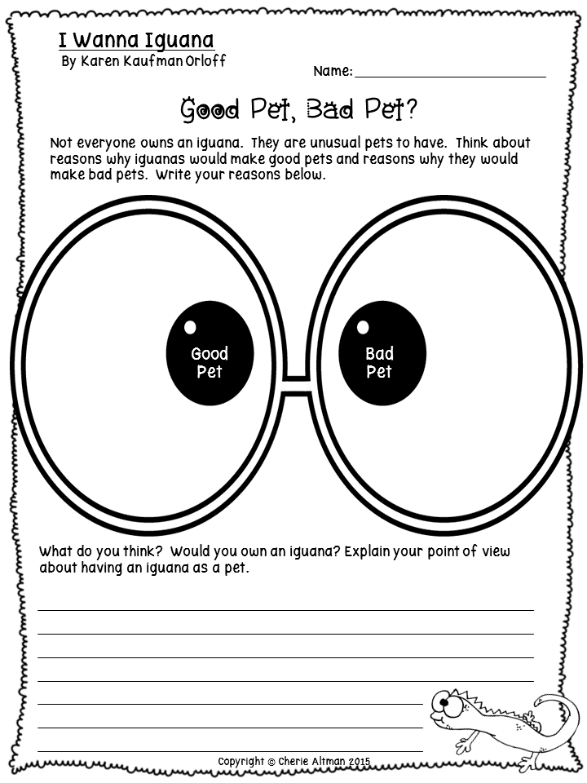
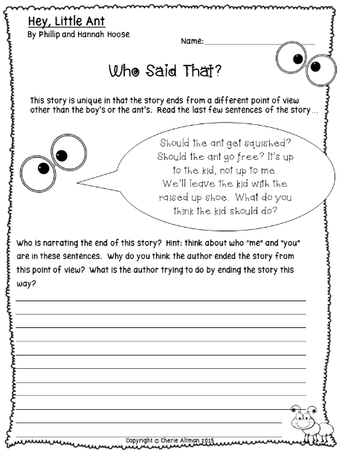
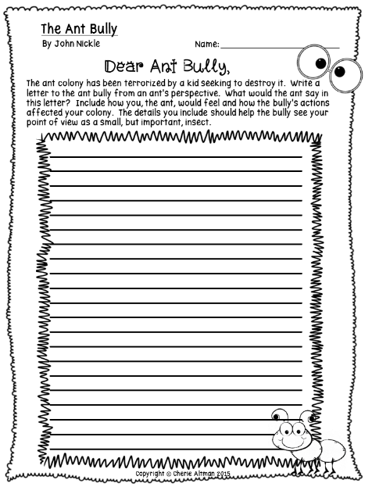
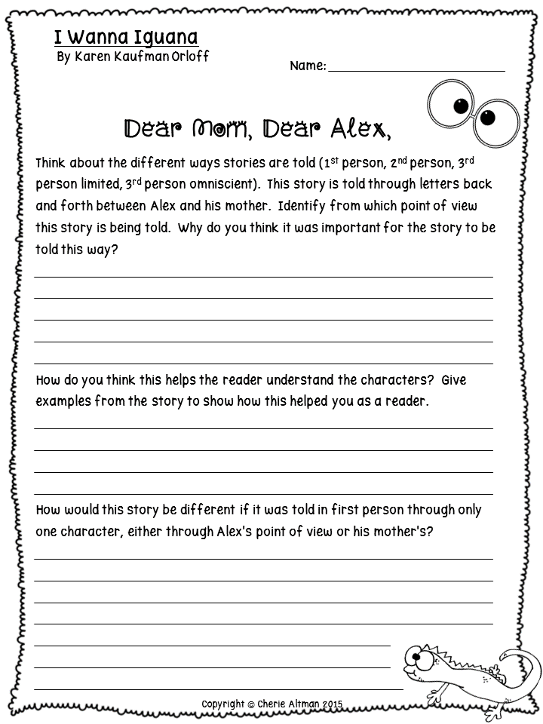
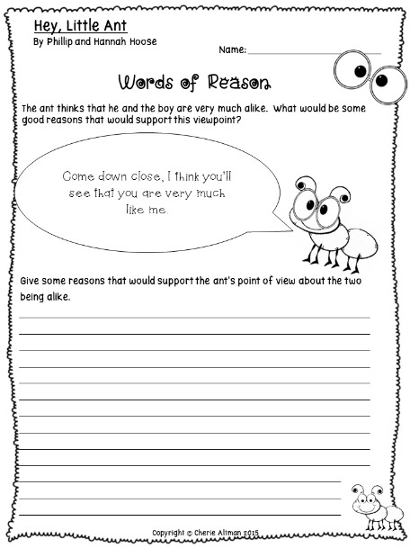
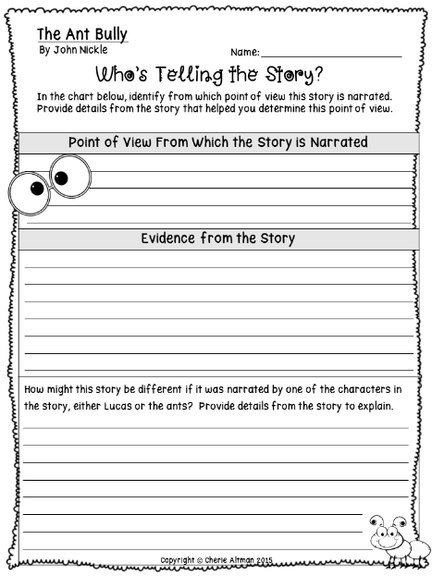
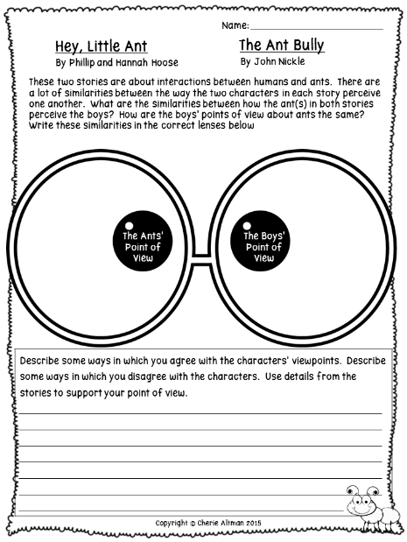
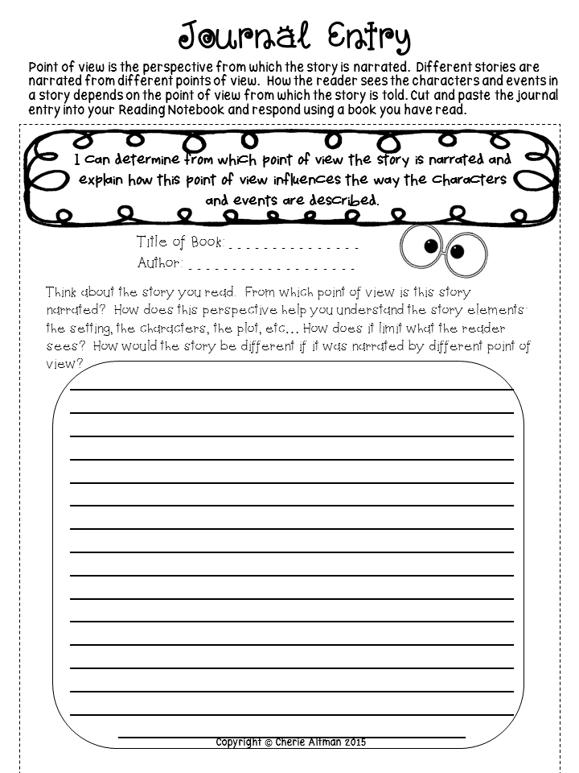
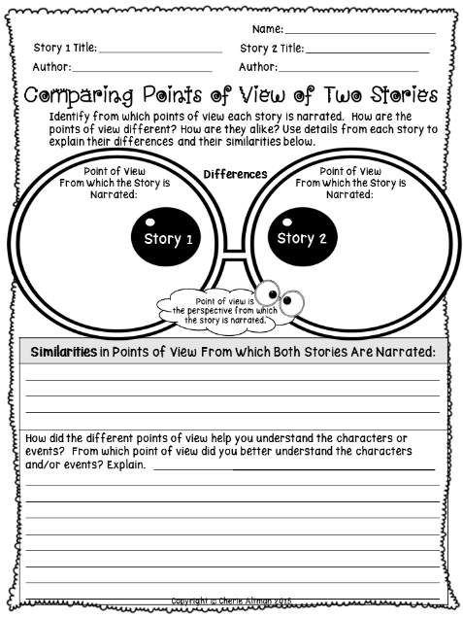
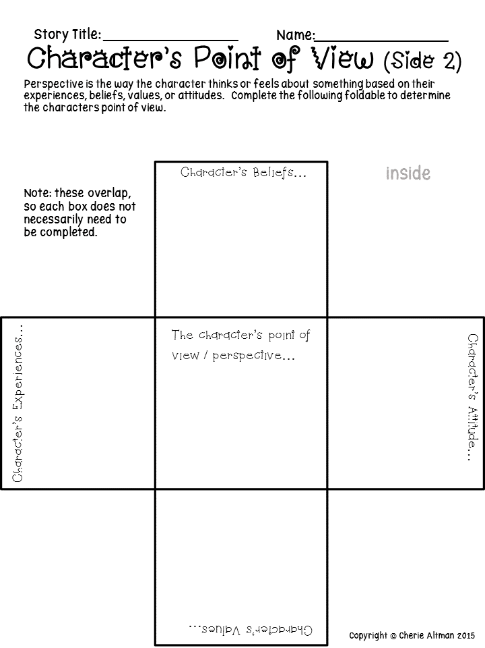
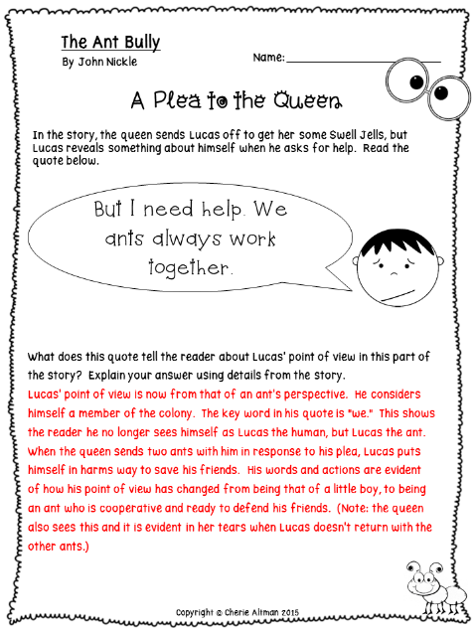
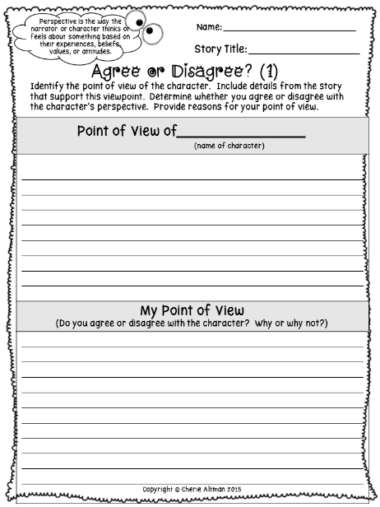
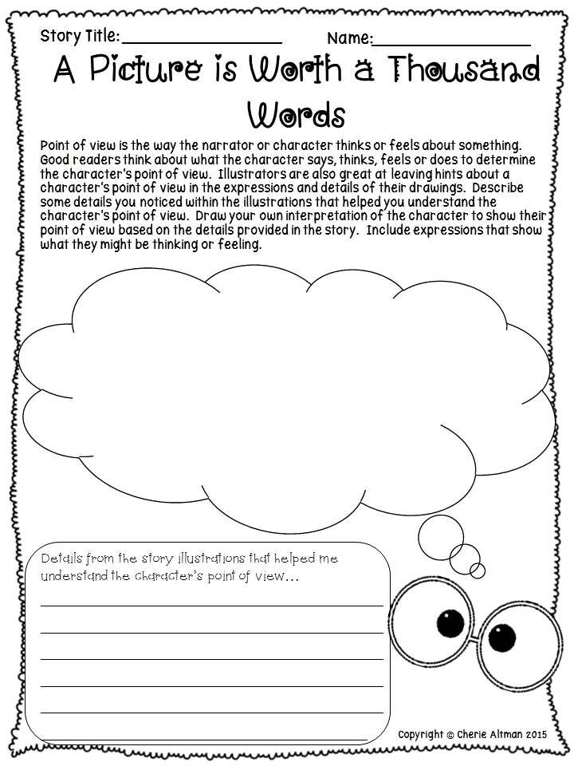
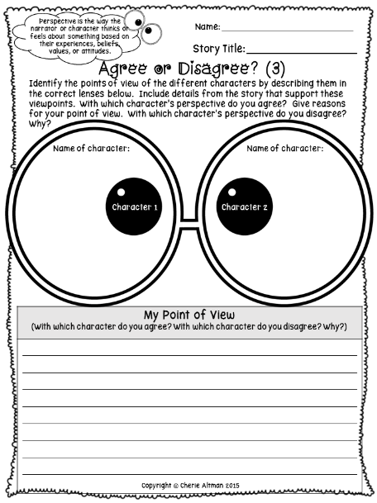
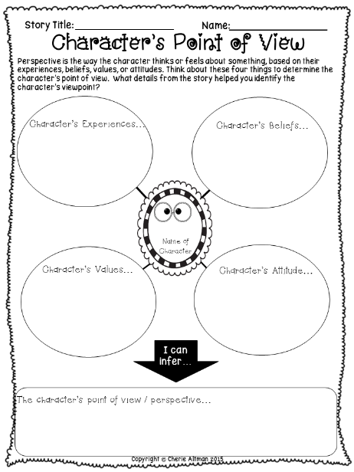
Answer keys
& 15 additional resources to be used with any story!

Slide 6
Preview

Slide 7
Preview

Slide 8
Preview

Slide 9
Preview

Slide 10
Preview

Slide 11
Thank you for your purchase!
If you have any questions or find a dreaded error, please email me at tcaltman@windstream.net. Please take the time to rate this product at my TpT store, follow me, and/or check out my other products. I appreciate your support and value any feedback or suggestions.
Click my logo to visit my store.
For More Standards based Resources, click the covers below:
Please remember this electronic download is limited to single classroom use only. You may not post or share anywhere online- including file sharing sites, blogs, shared WIKIspaces for colleagues, etc. If you would like to share with another teacher, you may purchase an additional license at my store.
Click the Apple core to visit my website!

